Slide 1

Infrastructure Intelligence Dashboard
JAN 2024

Slide 2




















MANAGEMENT TEAM
Enter your subhead line here
Dayse Rivera
Scrum Master
Larissa Roberta
Agile Team
Lidiane Parisi
Agile Team
Lucas Romão
Agile Team
Maísa Mendonça
Agile Team
Vinícius Guimarães
Agile Team

Slide 3

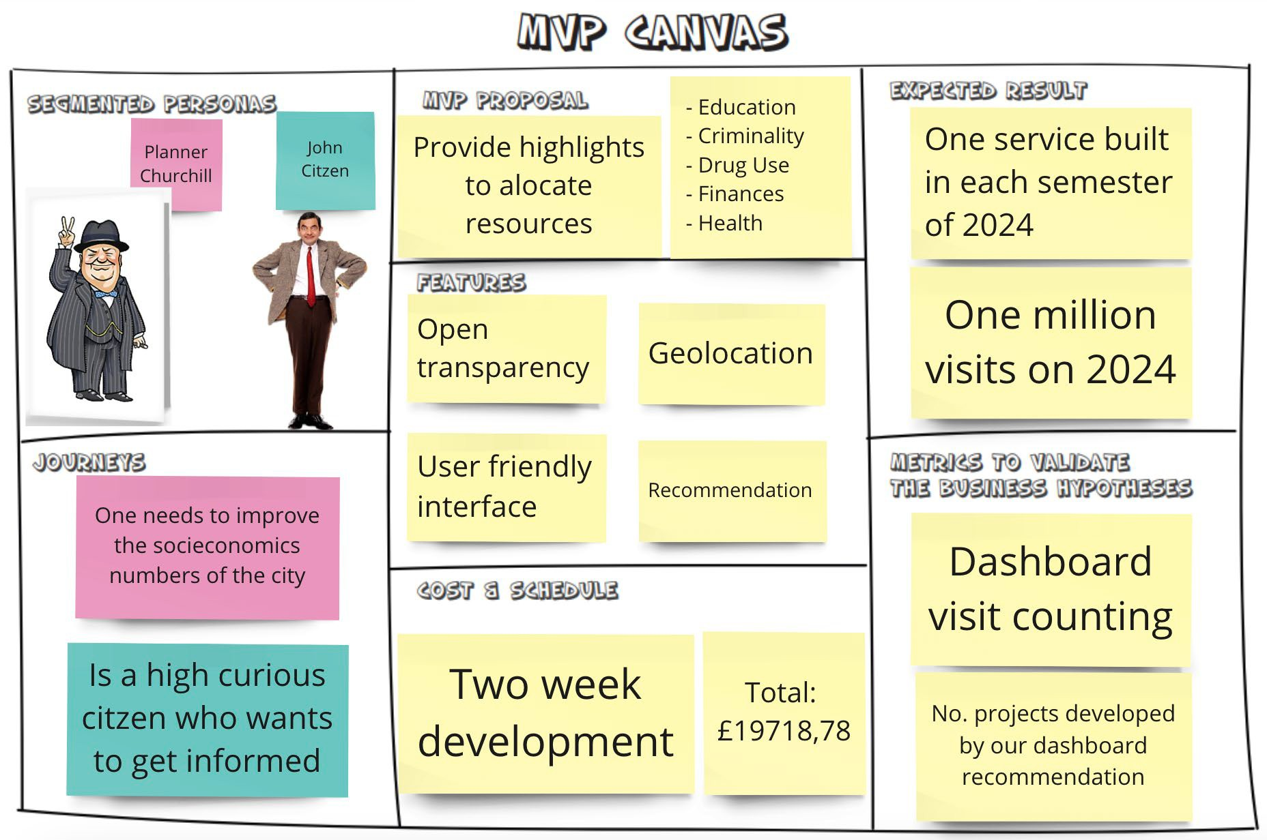
PROJECT DESCRIPTION
Where would be the best location in London to allocate public resources?
As City Planner
“I want To Have insights into criminality, education, financial well-being, health well- being, and drug use for each London borough so I can allocate resources in the necessary boroughs”
As citizen
“I want To observe the behavior upon criminality, education, financial well-being, health well-being, and drug use for each London borough so I can be updated on the socioeconomic data of my city”
*Caroli, P., 2017. Lean inception. São Paulo, BR: Caroli. org.
*Villamizar, H., et. al, 2023. Identifying Concerns When Specifying Machine Learning-Enabled Systems: A Perspective-Based Approach.

Slide 4
PROJECT COST
Service category | Service type | Region | Description |  | Estimated monthly cost
Compute | Virtual Machines | UK South | 1 B32ls v2 (32 vCPUs, 64 GB RAM) x 730 Hours (Pay as you go), Windows (License included), OS Only; 0 managed disks – S4; Inter Region transfer type, 5 GB outbound data transfer from UK South to East Asia |  |  | £847,74
Databases | Azure Database for MariaDB | UK South | General Purpose Tier, 1 Gen 5 (32 vCore) x 730 Hours, 5 GB Storage, 100 GB Additional Backup storage - LRS redundancy |  | £1.865,61
Compute | App Service | UK South | Standard Tier; 1 S3 (4 Core(s), 7 GB RAM, 50 GB Storage) x 730 Hours; Windows OS; 0 SNI SSL Connections; 0 IP SSL Connections; 0 Custom Domains; 0 Standard SLL Certificates; 0 Wildcard SSL Certificates |  | £285,43
Software | Data Vizualization Tableau |  | License |  | £720,00
Work Force |  |  |  |  | £12.000,00
Training |  |  |  |  | £1.000,00
Maintenance | Monthly |  |  |  | £1.000,00
Other costs |  |  |  |  | £2.000,00
 |  | Total |  |  | £19.718,78

Slide 5

Health Wellbeing
Data regarding mental and physical health of Londoners
Financial Security
Data regarding the financial situation of Londoners
Education
Data regarding vocational qualification of Londoners
DATASETS
London Datastore
01
02
03
Criminality
Data regarding crime rates around London
Drug Use
Data regarding the type of drugs used around London
04
05

Slide 6
DATA PREPARATION
Dashboard
Premises
Organized by Borough Time Range: 2016-2022
Health Wellbeing
Financial Security
Education
Select London and Borough rows
Split years
Select the following indicators:
Select the following indicators:
Select London and Borough rows
Used "Qualifications-of-working-age-NVQ" indicator
Add the year column in the tab sheet from 2016 up to 2021
Select the following indicators:
Rough Sleepers (%) - Calculated
Up-to-date with household bills
Unemployment rate
Reducing local income inequality (%)
Good physical health (no long-term limiting illness or disability)
A worthwhile and satisfying life
Healthy behaviors - healthy weight (adults)
Healthy behaviors - physically active adults
•
Estimate the years 2016 and 2017
NVQ4+ - percent,
NVQ3 - percent,
NVQ2 - percent,
NVQ1 - percent,
NVQ0 - percent
Drug Use
Criminality
Estimate the year 2022.
Create a total crime column
Select Major Text, columns
Transport the table
Aggregate historical months’ dataset
Select the indicators: drug-misuse-borough
Average and standard deviation calculation from the years 2006 to 2011.
Project the years 2016-2022 for borough.
Borough, and Count
dataset and 24 past

Slide 7

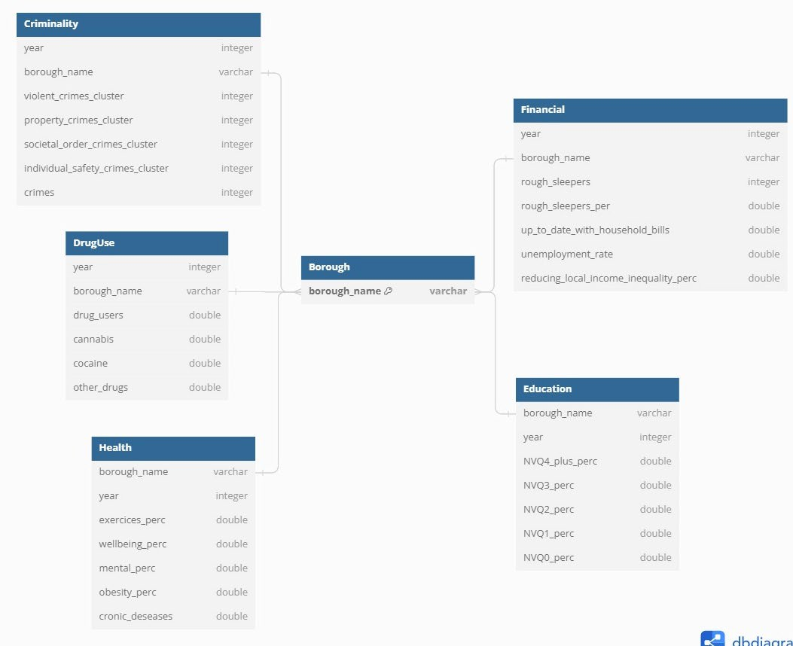

DATA MODEL
Data sheet
Questions were addressed and included the following topics:
Purpose and Origin
Composition and Representation
Data Characteristics and Labeling
Ethical and Legal Compliance
Collection Process and Validation
reprocessing and Data Integrity
Usage and Application
Distribution and Accessibility
Maintenance and Updates
Preprocessing and Data Integrity
Datasheet.pdf
Gebru, T., et. al, 2021. Datasheets for datasets. Communications of the ACM, 64(12), pp.86-92.

Slide 8
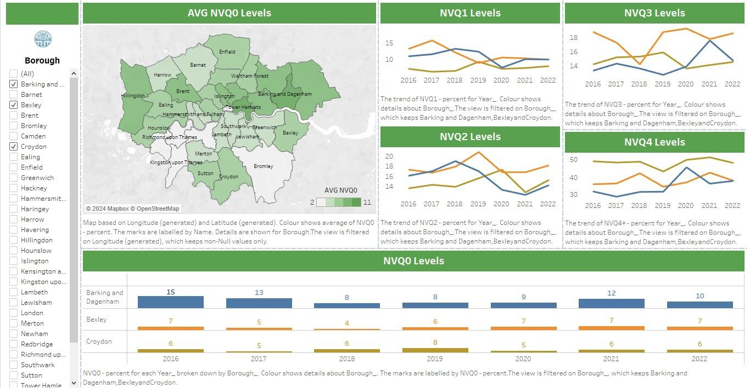

DASHBOARD
5 views
Health Wellbeing
Financial Security
Education
Criminality
Drug Use
Accessibility
Color blindness
Chart Descriptions
Reading Experience

Slide 9



RECOMMENDATIONS
* Correlation analyses
Health Wellbeing *
Based on worst Exercise rate: 'Barking and Dagenham', 'Newham', 'Brent']
Financial Security *
Based on worst Up-to-date with household bills rate: 'Hounslow', 'Haringey', 'Merton']
Education
Based on worst 'Richmond upon Thames', 'Wandsworth', 'Kingston upon Thames'
Criminality
Based on highest No. Crimes: 'Westminster', 'Newham', 'Southwark'
Drug Use
Based on highest No. Users: 'Tower Hamlets', 'Islington', 'Hackney'

Slide 10
OUR WORK
Agile Team
Daily Meetings
Working in Pairs
17/01
18/01
22/01
23/01
24/01
Ideation
Data Selection
Data Treatment
Data Modeling – Data Sheet
Dashboard
Analysis and Recommendation
Presentation

Slide 11
T H A N K Y O U

